Slide 1

Equipment and Material
Merced Energy, Battery Park

Slide 2
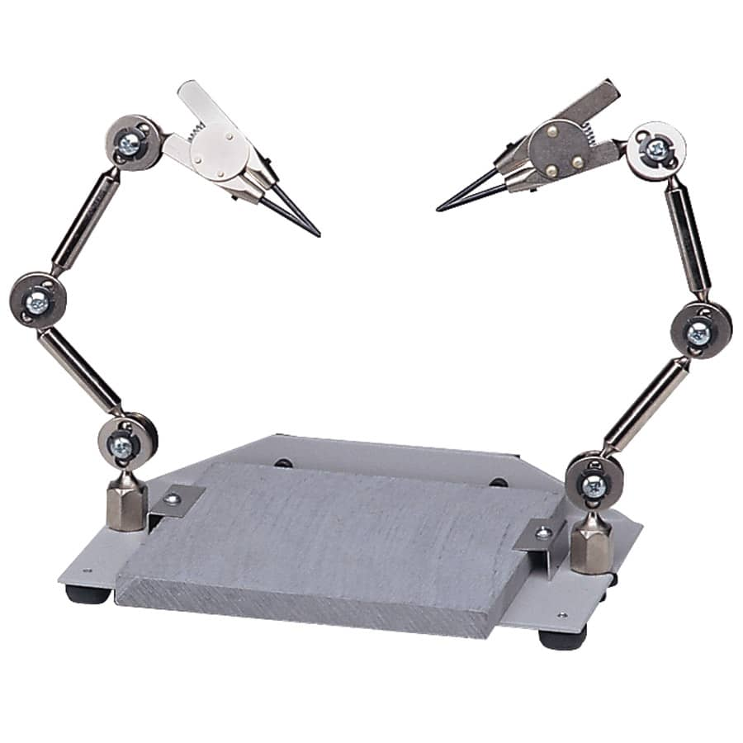
Third Hand
The third hand is an adjustable tool used to hold components while you are soldering.
They can be used to hold wires, PCBs, etc.
They may damage wires, but you can mitigate the damage using shrink wrap.

Slide 3
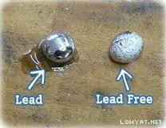
Solder
2 types: lead solder and lead-free solder
Lead-free solder requires more heat
Lead-free solder joints are grainy and rough. They are lower quality than lead solder.
Lead solder is recommended because it is easier to work with and requires lower temperatures.

Slide 4
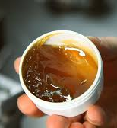
Flux
Usually made of rosin
Comes in paste form
Reduces oxides that form whenever hot metals are in contact with the air.
It also helps the solder stay in liquid form.
Many solders come with flux in the core.

Slide 5
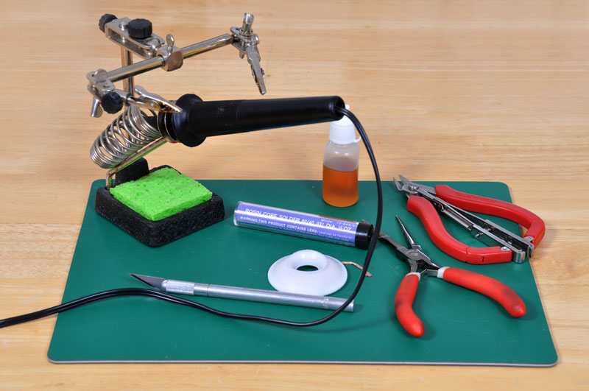
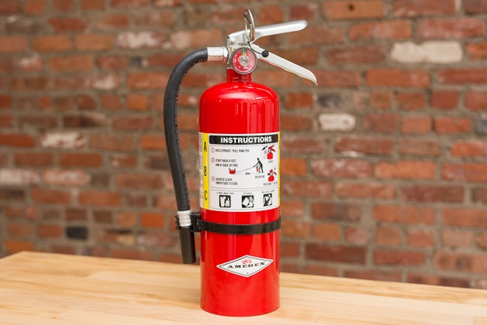
Equipment
Soldering iron & stand
Third hand
Wet sponge
Solder
Flux
Fire extinguisher

Slide 6
Safety
Wash hands before and after soldering especially if you are using lead solder!
Wear eye protection
No jewelry
Handle with care as the soldering iron is very hot
Always return soldering iron to its stand
Make sure whatever you’re soldering is not connected to electricity

Slide 7
Thank You!
Raymond Kim
Liza Oh

